Slide 1

A SALESFORCE DEVELOPER VIRTUAL INTERNSHIP
Presented by
P. Jagruthi 19121A1587
Department of Computer Science and Systems Engineering
SREE VIDYANIKETHAN ENGINEERING COLLEGE
(AUTONOMOUS)

Slide 2
Contents
Abstract
Module Description
Conclusion
References
Certificate

Slide 3
Abstract
Salesforce is a cloud-based software company that provides businesses with tools that help them find more prospects, close more deals, and provide a higher level of service to their customers. Salesforce is a popular CRM tool for support, sales, and marketing teams worldwide. Using the Salesforce CRM, companies can track customer activity, market to customers, and many more services. A CRM platform helps you go deeper with all metrics and data and that data is shown visually. The Trailblazer Community helps to learn relevant skills, connect with other Trailblazers. Salesforce developer catalyst is done with the help of trailhead and trailblazer platform. A Salesforce developer is a special type of computer programmer who writes software on the Salesforce CRM platform. This ranges from creating websites to developing apps. A Salesforce developer works with computer code like JavaScript and HTML on a daily basis.

Slide 4
MODULE DESCRIPTION
Lightning App Builder
Flow Builder
Automate Business process for Recruiting App
Build a Discount Approval Process
Quick Start : Lightning App Builder
Quick Start : Flow builder
Data Management
Event Monitoring

Slide 5
MODULE DESCRIPTION
The Lightning App Builder is a point-and-click tool that makes it easy to create custom pages for the Salesforce mobile app and Lightning Experience. It gives users what they need all in one place. Flow Builder is the declarative interface used to build code-like logic without using a programming language. Flows are able to create, edit and delete records in Salesforce, send e-mails, show relevant data and gather input from users and generate outbound messages. Automate Business Processes for a Recruiting App Create records, processes and flows with Process Builder and Cloud Flow Designer. Build a Discount Approval Process is to Approve or reject discount requests through your website. Free automated approval flow template for business. In Quick start: Lightning App Builder we can add more components and more actions to the page which we have created. Process Builder is a work flow tool that helps automate business process without writing single line of code. In Data Management data is stored all over the place. Event Monitoring is one of many tools that salesforce provide to help keep your data secure.

Slide 6
Conclusion
More than 150,000 companies use Salesforce CRM to grow their business by strengthening customer relationships. Since a few years back, Salesforce has been climbing the charts for increasing productivity, predicting sales revenue, improved customer visibility, efficient pipeline management, etc. When it comes to customizing marketing messages to send them to the right person on the right channel at the right time, Salesforce emerges as a helpmate. Besides, it helps in improving lead generation, upselling and cross-selling, and customer acquisition opportunities.
So, I finally conclude that Salesforce is very important and major technology. I learned many things from this internship.

Slide 7
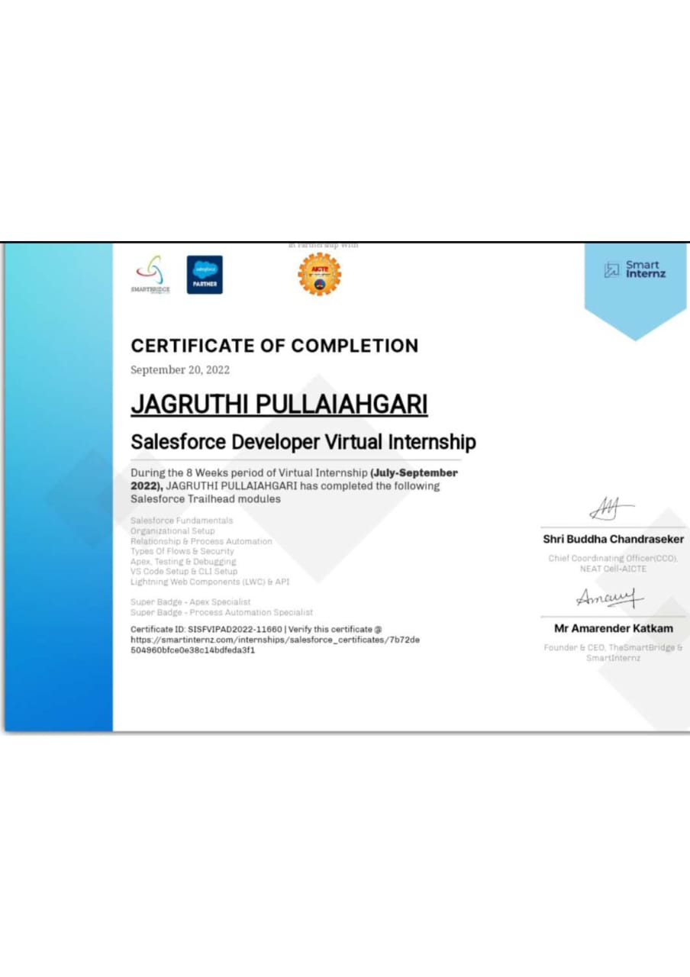
Certificate

Slide 8
References
https://trailhead.salesforce.com/
https://developer.salesforce.com/
https://trailblazer.me/id/srenichowdary16

Slide 9
THANK YOU

